Slide 1

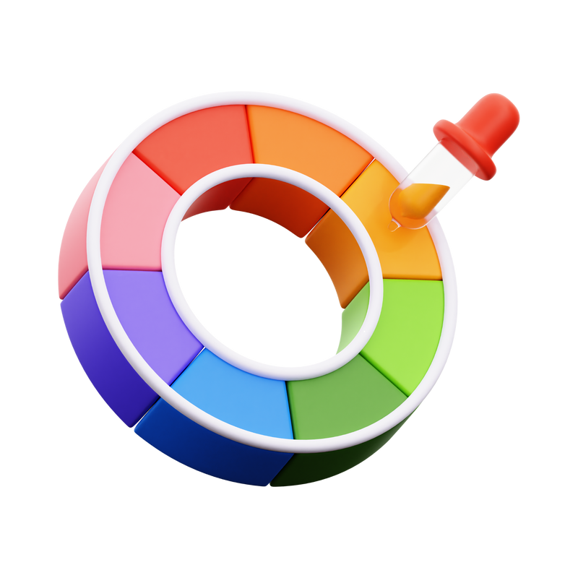
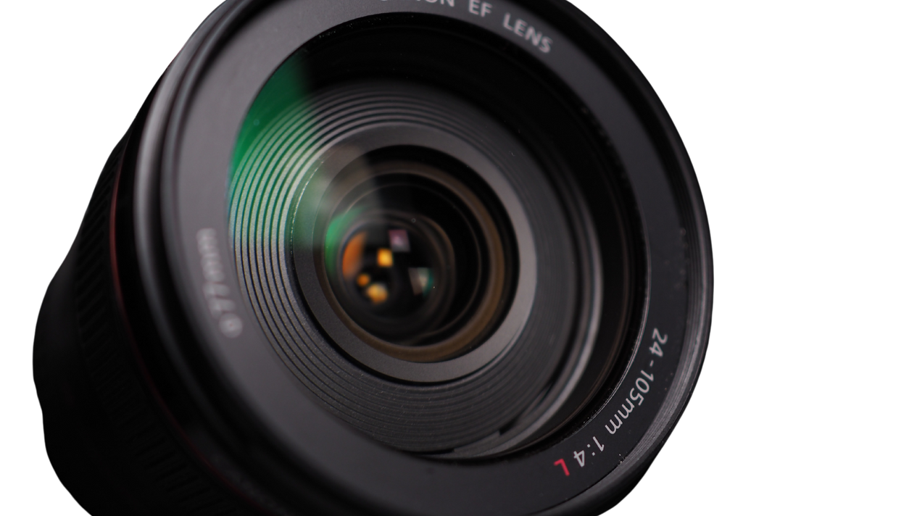

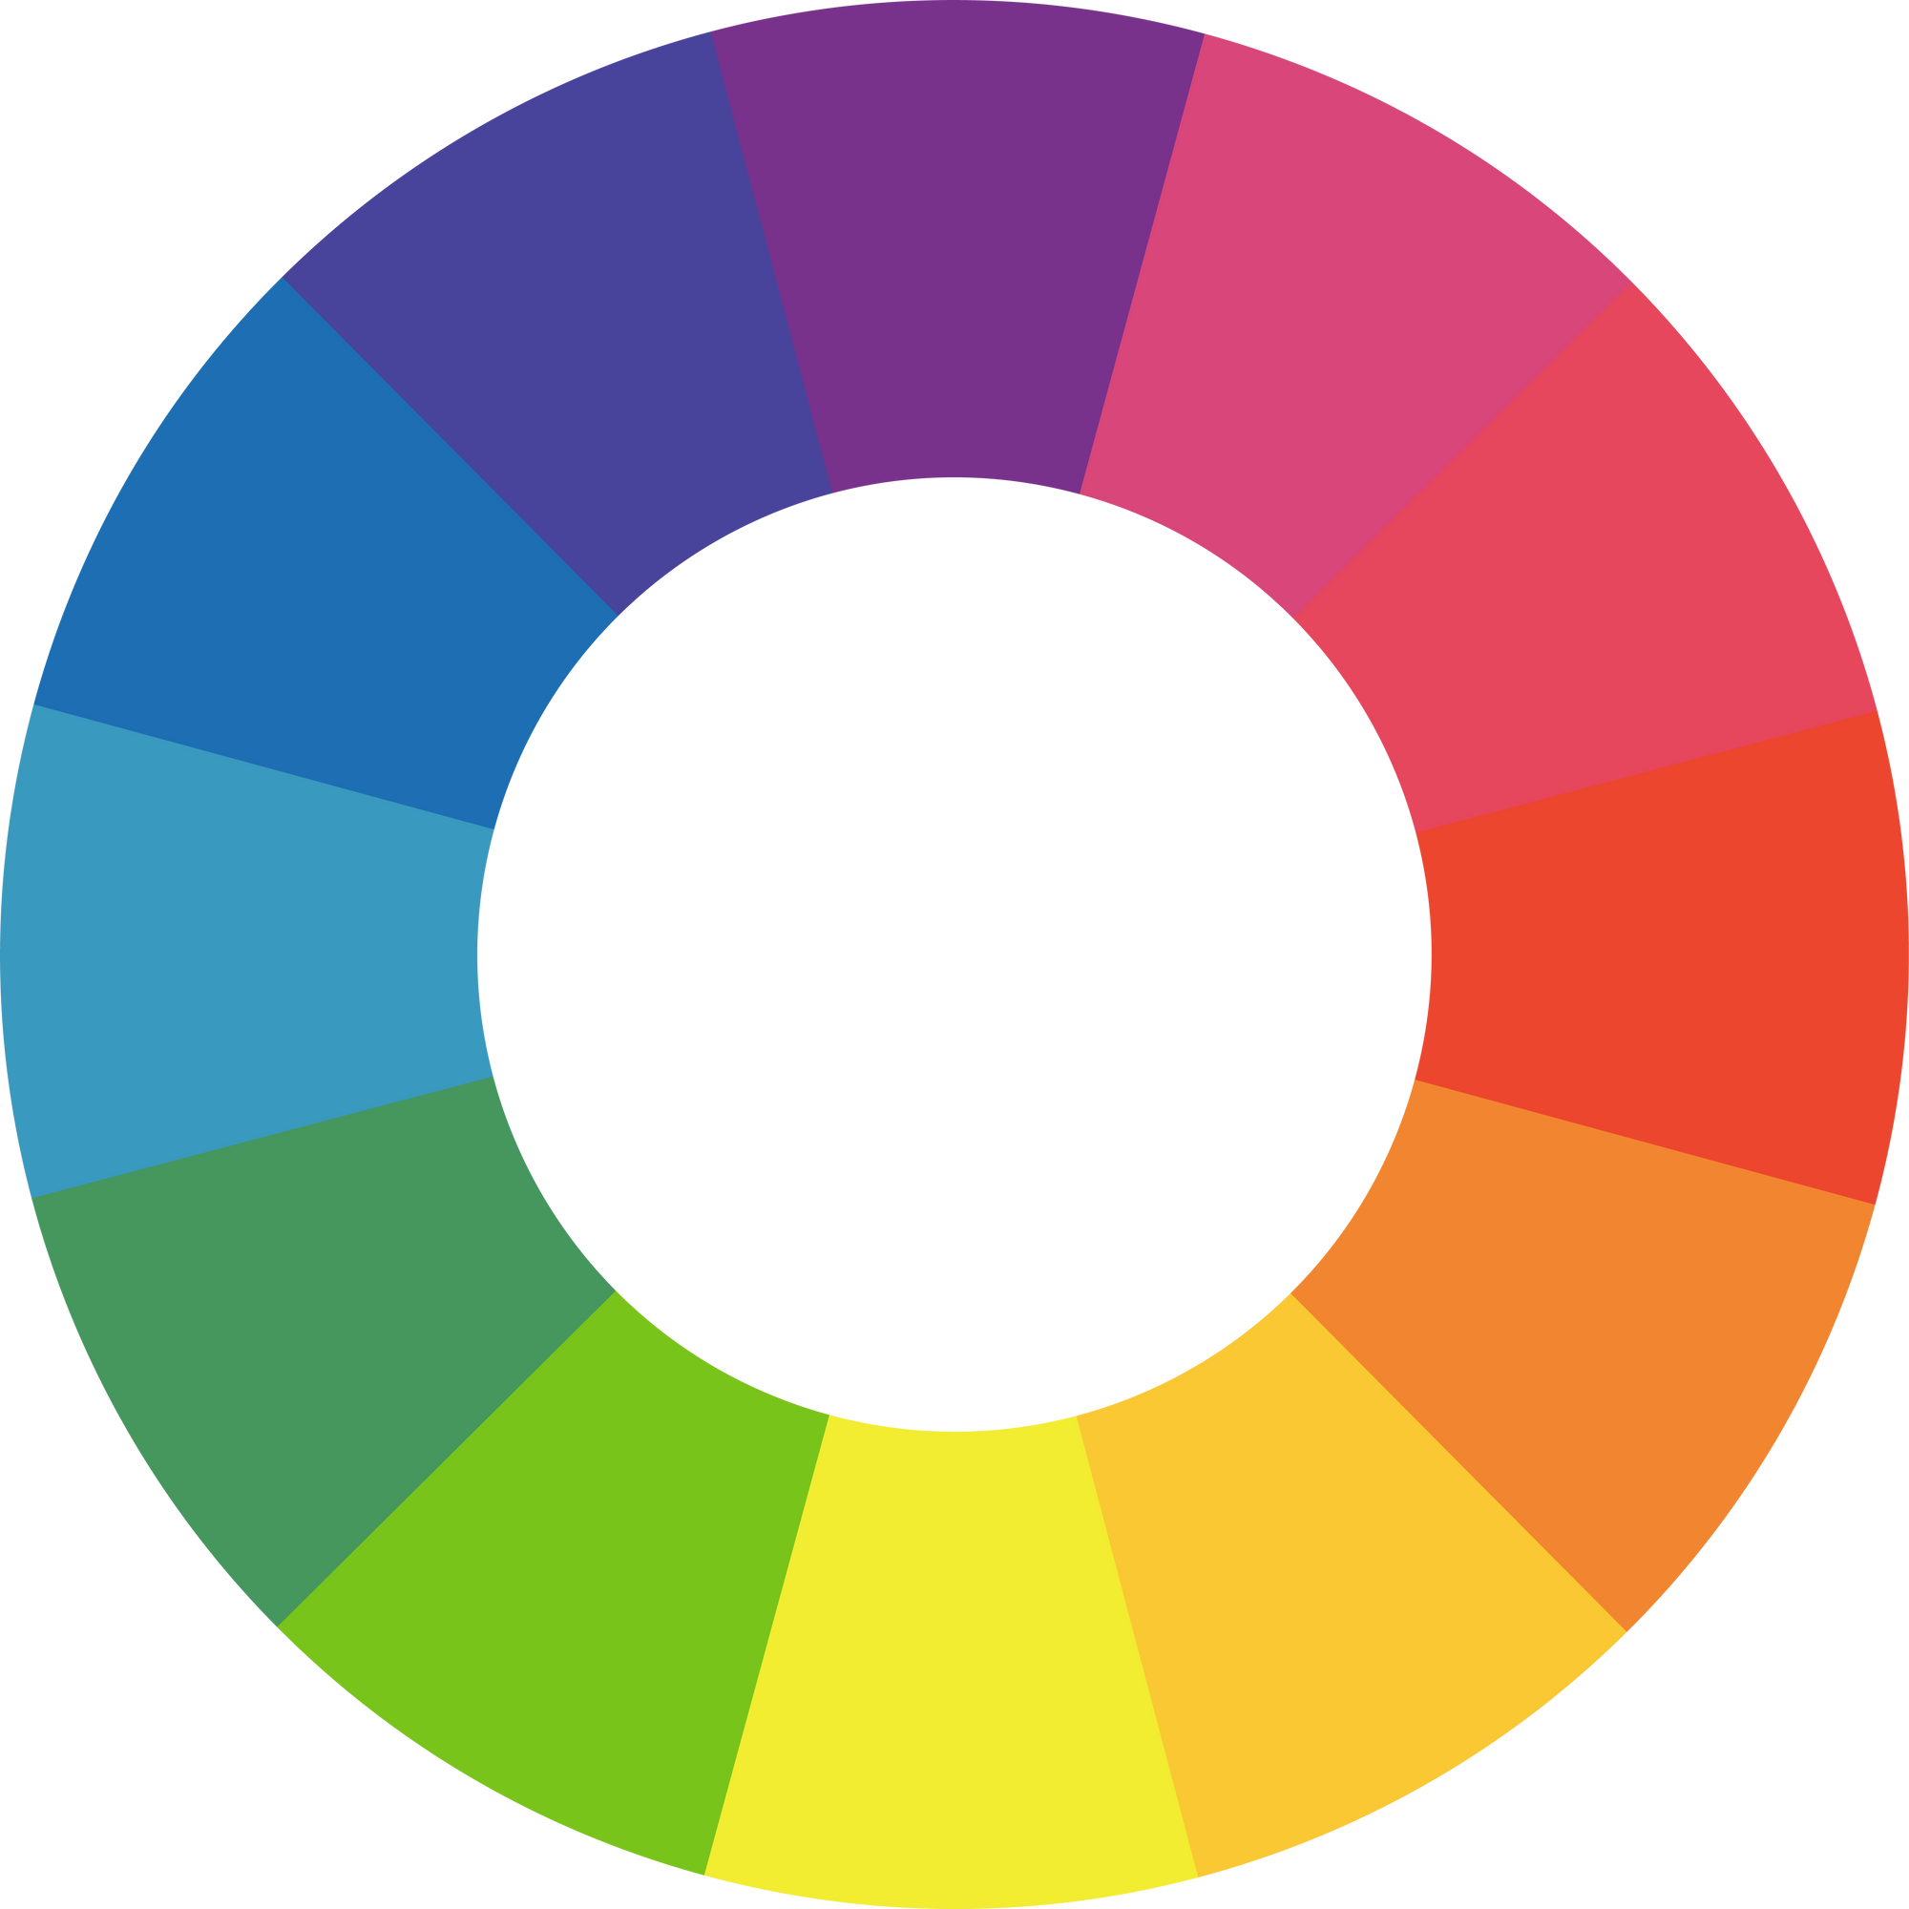
Col
rEye
Discover the colors around you

Slide 2









About
Frontend
ColorEye is web application leverages computer vision techniques to detect and label various colors in real-time using a webcam. Built with Flask and OpenCV, it provides an intuitive interface where users can:
Backend
Computer Vision

Slide 3
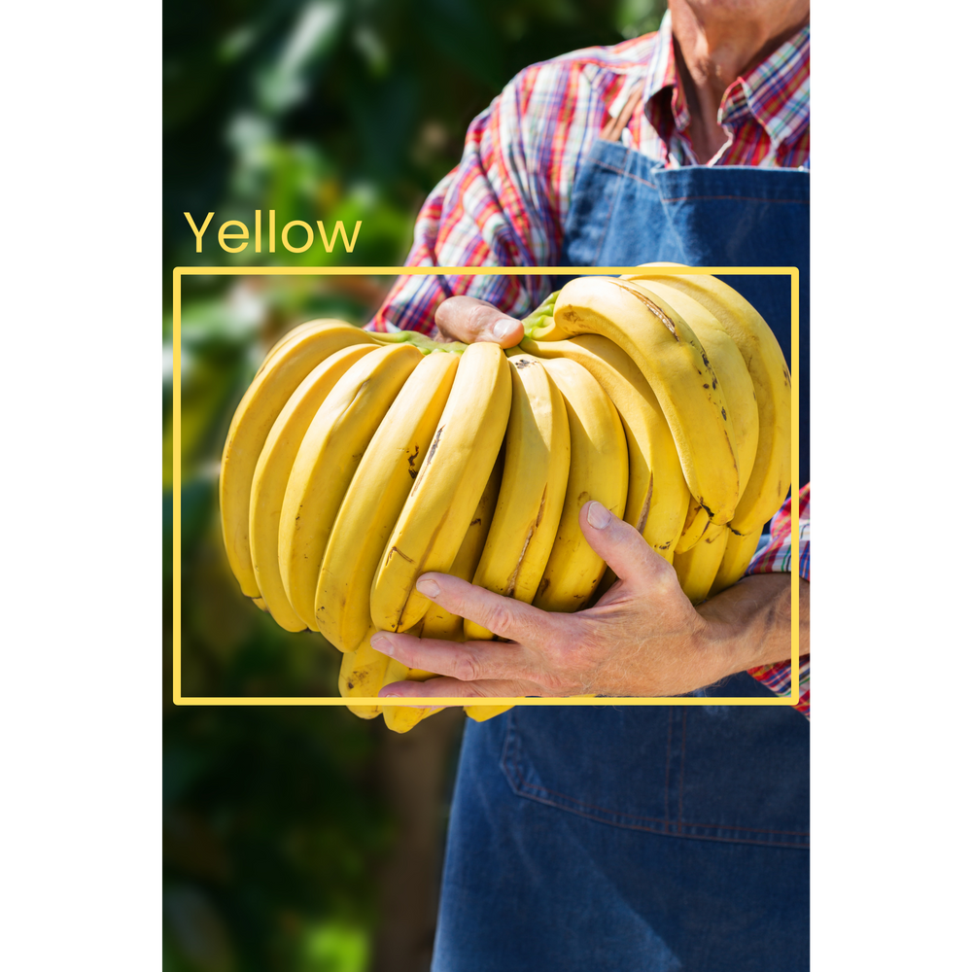
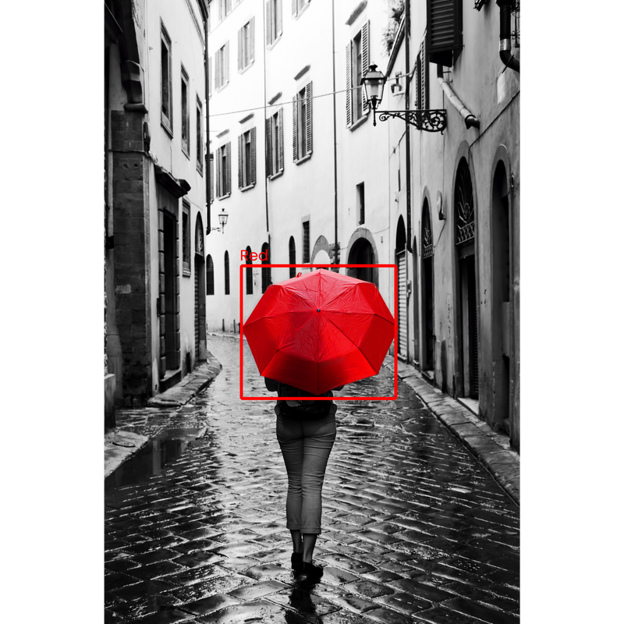
Real-Time Video Feed
The application captures video from the user's webcam and processes each frame to detect predefined colors.

Slide 4
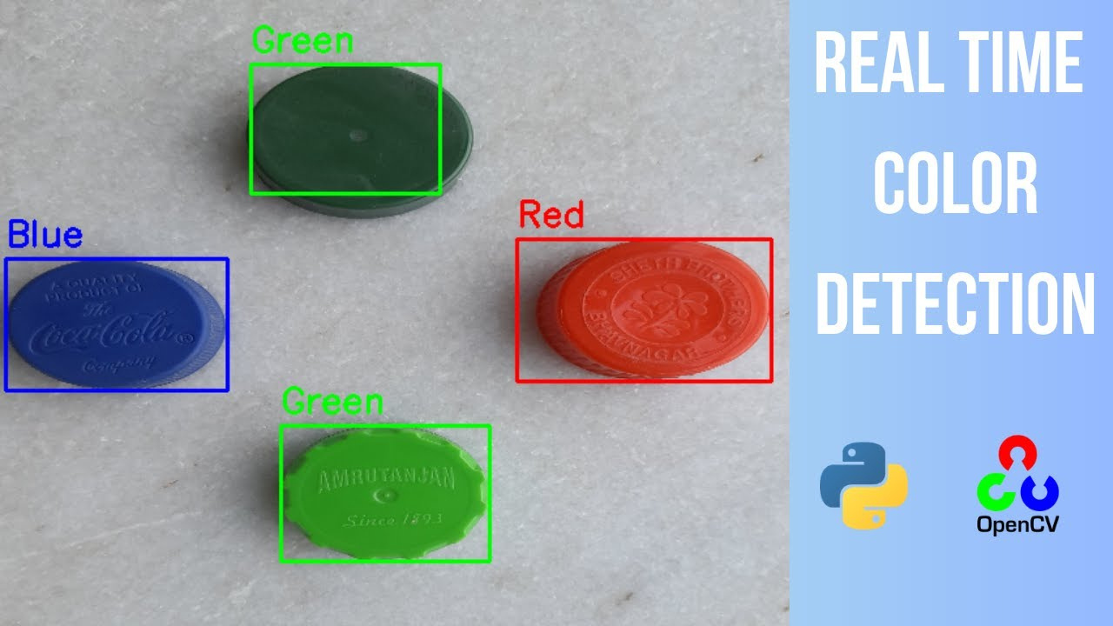
Capture Images
Users can capture a frame from the video feed that contains the detected and labeled colors. After capturing an image, it allows the user to download the image for future use.

Slide 5


Col
rEye
is ideal for:
Early Childhood Education
It allows toddlers to classify color at early age at ease with the use of modern computer vision.

Slide 6
Col
rEye
Thank You!

Slide 7





Col
rEye
Our Team
Rhenmark Rey A. Obedencio
Ronald V. Musico
Shaly S. Gangca

